Slide 1
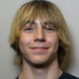
Clippd
Team A
EunHyuk Doo | Isaac Hur | Kwesi Mireku | Swayam Shrestha | Ted Turnage
CS262 Lab 10
Nov/14/2025
Notes:
Roles:
Ted: Vision, key user stories
Isaac/Swayam: Domain and Design
Kwesi: App demonstration
Kai: Narrating demo, Status report
Structure:
Vision
Analysis and Design
Domain model
UI model
Key user stories
Information systems design
Demo
Status Report
Q&A
Professor wants Ted’s freshman pic as a hook to grab attention

Slide 2
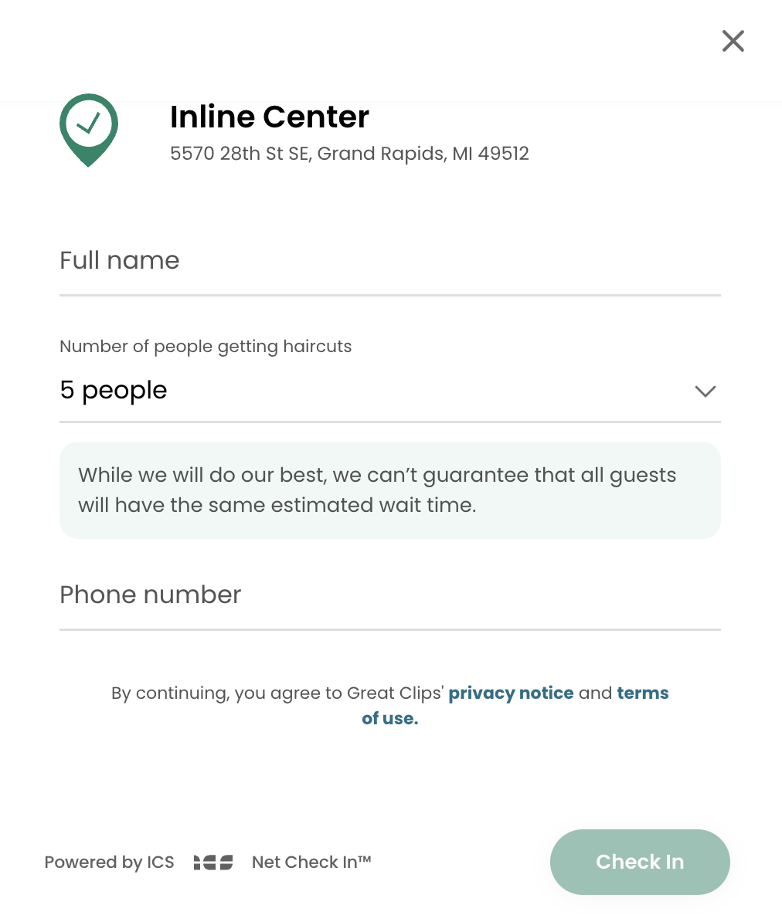
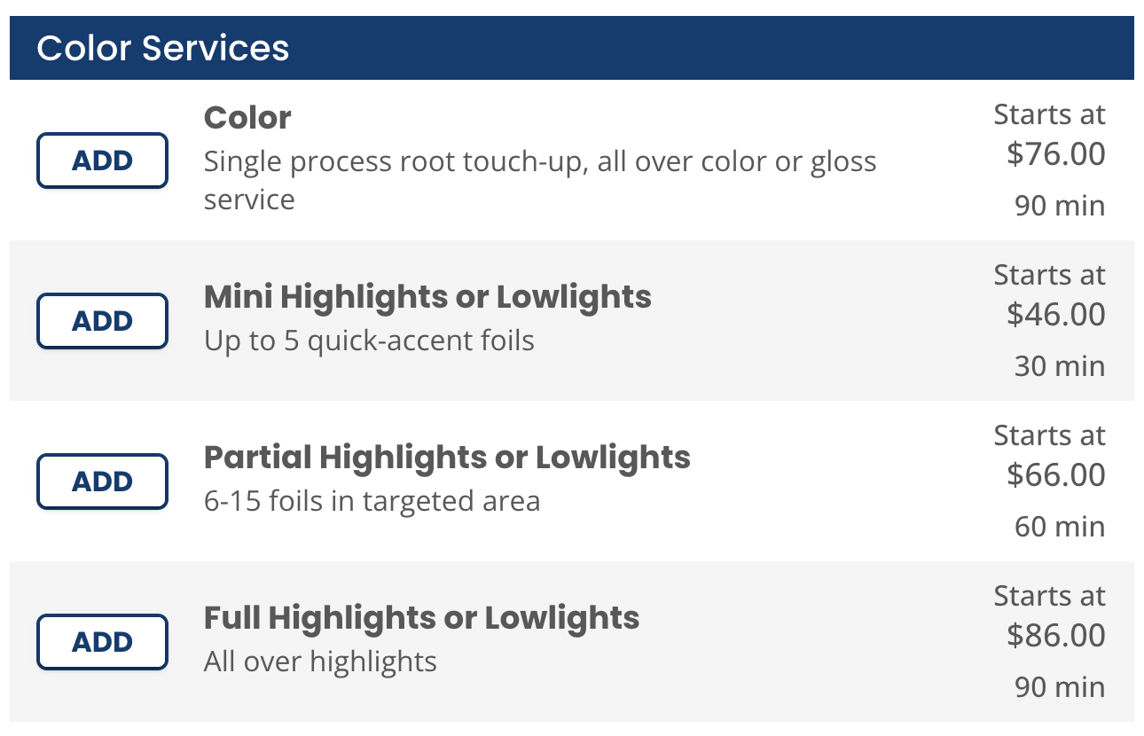
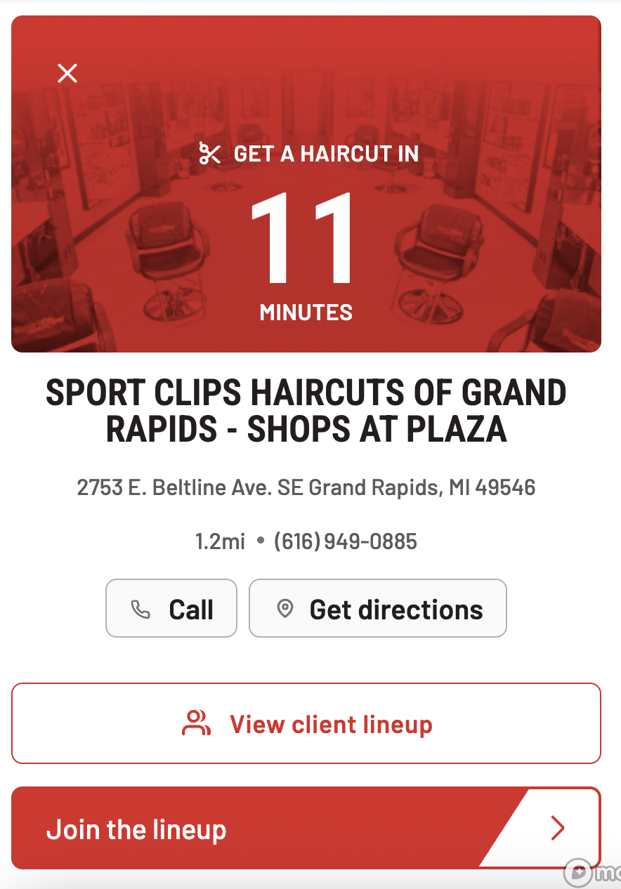
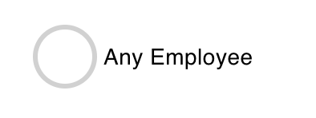
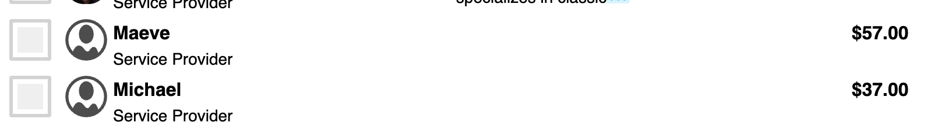

Slide 3
Product
Demo
Notes:
User stories to include:
As a user who values personalized services, I want to get a personal view of the person giving me a haircut or styling by my showing me their work visually and not just telling me about it.
As a user, I want to add Clipprs to my favorite’s list so that I can easily find and book them again later.
As a customer looking for a professional, I want to be able to accurately sort the providers by distance so that I can find professionals who are conveniently located near me and minimize travel time.
As a person with specific needs, I want to be able to conveniently find someone who is a match with my hair type and what I want to do with it.
As a service provider, I want to presentably share my portfolio in detail to clients by providing real results as well as my specific set of skills

Slide 4
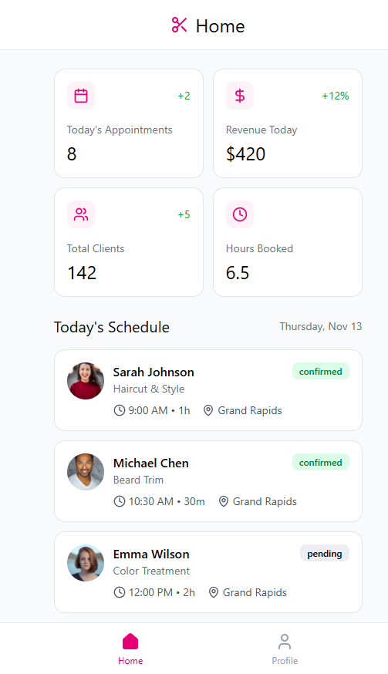
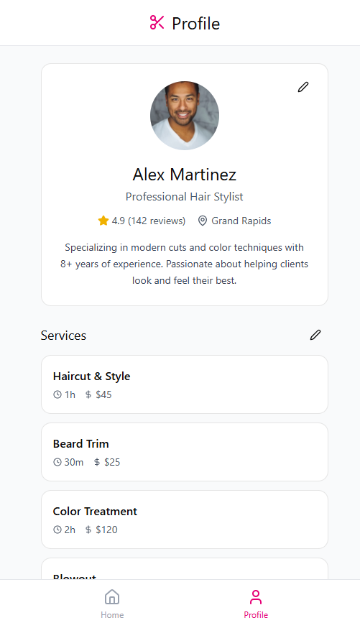
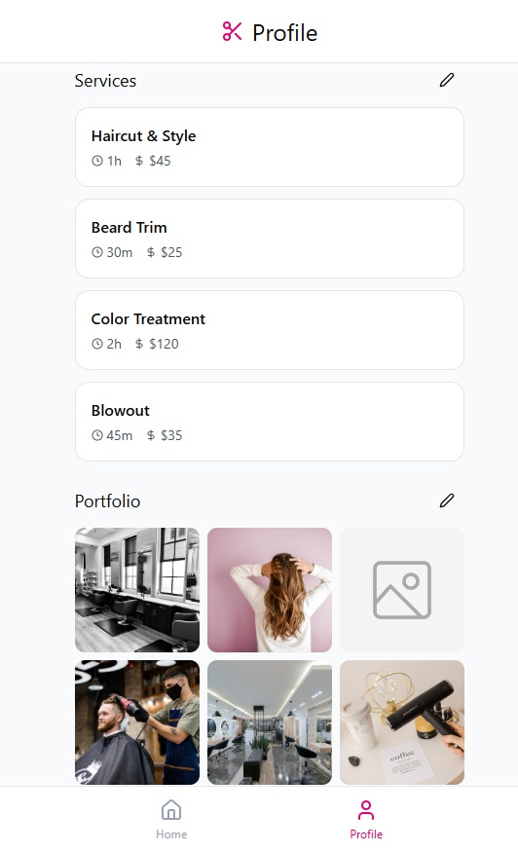

Slide 5
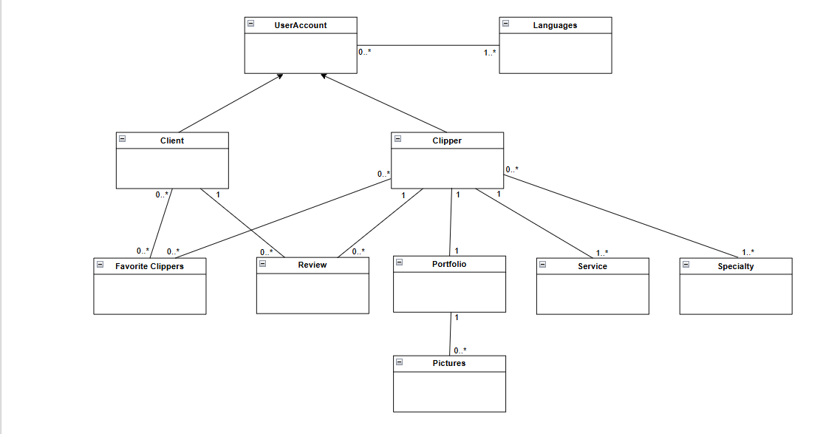
Key takeaways
..*
Notes:
1 ..* from clippers to service

Slide 6

Upcoming Tasks
Connecting Frontend to the Backend
Google Maps
Design Upgrades

Slide 7

Ask us anything!

